Slide 1
ABCON AGM 2021
NIGERIA DATA PROTECTION REGULATION (NDPR) & OTHER APPLICATIONS
DataPro Ltd Since 1995
14 April, 2021
Practice Over Theory

Slide 2
CONTENTS
Talking Points
NDPR Features
NDPR Proposition & Road Map
RegTech & API
API & Compliance Functionality

Slide 3
TALKING POINTS
What is NDPR?
Why should BDCs Comply?
What benefits to BDCs?
How can it help BDCs to become more effective?
Any nexus between Cybercrime and NDPR violation nexus?
How can BDCs use NDPR Compliance to unlock opportunities?
How can BDCs relate to RegTech & New Technologies
What new applications can help BDCs in Compliance obligations?
What is API?
What is the nexus between API & Compliance?
How can BDCs leverage on API for Compliance functionality and greater productivity?

Slide 4
WE LIVE IN A NEW WORLD
Globalized, borderless World.
Interconnected, Dynamic and constantly changing
New Technologies, Social Media are redefining how we live and conduct business
Digitalization is driving companies and commerce
Data is the new Gold. A new paradigm shift has emerged
Regulation & Compliance affect BDC Operations
So much Collaboration, Cooperation and Coordination by Regulators, LEAs and Supervisors on Compliance issues. No hiding Place for defaulters
Zero Tolerance to Non Compliance is a Survival- kit

Slide 5
NDPR FEATURES
On the 25th of January 2019, the National Information Technology Development Agency (NITDA) issued the Nigeria Data Protection Regulation (NDPR) to align Nigeria to the other parts of the world in advancing the cause and spirit of data protection and privacy needed for operationalizing the now digital and virtual world.
The NDPR is mirrored after the European GDPR which is touted as the most functional and comprehensive framework in the world.
The NDPR mandates Data Collectors and Processors of personal data to set up Policies, Programs, Processes, Procedures and Internal Controls to fulfil their compliance obligations

Slide 6
DATA PROTECTION
Data Protection is about Data Security
It ensures that personal data is safeguarded from unlawful access by unauthorized parties
It protects organizational assets by “keeping threats out”
Data Protection is a Governance issue
If you collect personal data, then you have the responsibility of protecting it from unauthorized access

Slide 7
DATA PRIVACY
Data Privacy is a constitutional (Section 37) and human rights issue
Every Nigerian therefore has a right to data privacy
This dictates the rights of Nigerians over their personal data
If you collect personal data then you must respect privacy rights
The NDPR ensures privacy rights

Slide 8
NDPR VALUE PROPOSITION
To protect and safeguard the rights and freedom of every Nigerian over their personal data (Data Protection and Privacy is now a fundamental right)
To protect and secure organizational personal data against leakages, theft, misuse and breaches
To foster safe conduct of transactions involving the exchange of personal data by customers/clients of both public and private organizations (Consumer Protection is a major pillar of government legislation)
To prevent the processing of personal data without obtaining consent ( To stop the illegal use of personal data for political, marketing and sales purposes without the consent of the Data Elements)
To prevent Cybercrime and avoid civil and criminal prosecution of employees and directors of organizations
To ensure that businesses and government agencies in Nigeria remain competitive in international trade (Global Competitiveness)
To guarantee the sustainability of businesses locally through safe and sound practices that will protect their reputation and increase customer confidence (Mitigating Breaches )
To manage Regulatory Compliance Risks and avoid NITDA Penalties & Fines

Slide 9
6 QUICK COMPLIANCE WINS
The NDPR requires Data Controllers & Processors to:
Compile Data Protection Compliance Policy & Review all Agreements involving Data Exchange
Appoint a Data Protection Officer (DPO)
Conduct a Data Protection and Privacy Compliance Awareness Training for all Staff, Directors & Stakeholders
Conduct Data Protection Impact Assessment (DPIA)
Conduct annual Data Protection Audit
File Audit report through DPCO to NITDA annually

Slide 10
UNLOCKING OPPORTUNITIES WITH NDPR COMPLIANCE

Slide 11
AML/CFT COMPLIANCE

Slide 12
API TECHNOLOGY

Slide 13
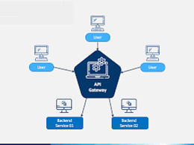
AVAILABLE TO ALL ABCON MEMBERS

Slide 14
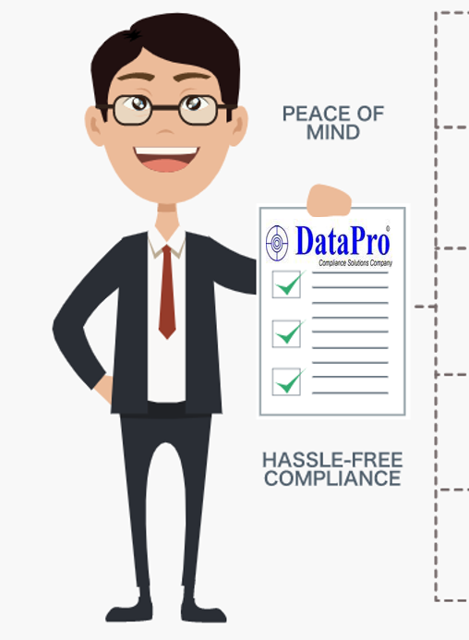
FUNCTIONALITY
ID VERIFICATION
(BVN, Voters Card, Drivers License, Passport, NIN)
Our API platform enables end-users perform the following searches and verifications in line with KYC and Due Diligence Requirements
ADDRESS VERIFICATION
CAC COMPANY SEARCH
POLITICALLY EXPOSED PERSONS SEARCH
SANCTIONED PERSONS SEARCH
BLACK-LISTED PERSONS SEARCH

Slide 15
API VALUE ADDED
Unified and uniform compliance system for all ABCON Members
Saves Time & Money in Compliance Setup
Improved efficiency and increased productivity
Innovation, competitive advantage and revenue growth
Customer satisfaction and protection
Easier & Faster Reporting TOT
Ensures Regulatory Compliance
Increased brand value and reputation

Slide 16
CONCLUSION

Slide 17
THANK YOU

Slide 18
Q & A

Slide 19
CONTACT
@
DataPro Limited
Ground Floor, Foresight House
163-165 Broad Street, By Marina WaterFront, Lagos Island, Lagos.
 234-803-309-1467
E-mail: adeseyoju.abimbola@datapronigeria.net Website: www.datapronigeria.net

